Slide 1


Assessment of Collaborative Workforce Training in Geoscience and Social Science for Natural-Hazards Preparedness and Mitigation (HAZPM)
By: Sinera Williams
HAZPM Team: Steve Semken, Heather A. Fischer, Elizabeth A. Wentz, Patricia Gober, Angel Garcia
School of Earth and
Space Exploration
School of Geographical Sciences and Urban Planning
Arizona State University

Slide 2
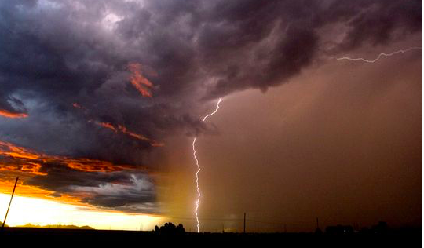
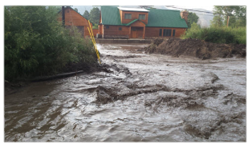
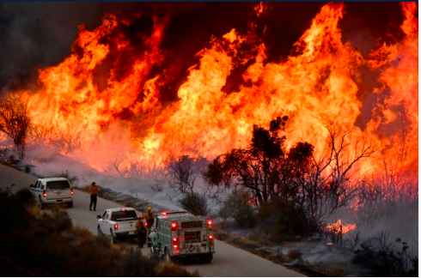
Recent Climatic Events
Photo: Michael Chow/The Republic
Photo: Tom Vigil/National Weather Service
New Mexico Mudslide 2018 (Top Right)
California Wildfire 2018 (Bottom Left)
Arizona Monsoon 2018 (Top Left)
Photo: Reuters/CBS News

Slide 3







Introduction
Goal: culminate undergraduate workforce training certificate program that fully integrates relevant natural and social sciences
Useful to hazards-minded students majoring in geoscience, natural sciences, social sciences engineering, planning, sustainability, and many other fields
Catalog hazards workforce needs of agencies and organizations

Slide 4
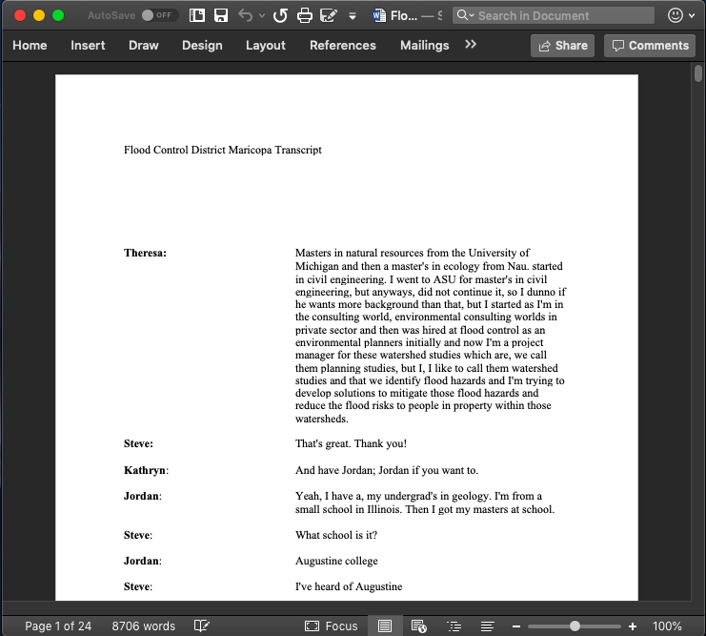
Methods
Focus groups
NVivo Coding Program
Focus Group Questions
What are the natural hazards your organization is concerned about?
What are your organization’s biggest challenges in addressing natural hazards?
What are your organization’s workforce needs?
What knowledge and skills should students learn to best prepare them to work in your organization?
What learning experiences and instruction best enable students to learn these?
What are the knowledge gaps in your entry-level employees?
With what other organizations do you work most closely?
What future opportunities do you envision for your organization?
What future threats do you envision for your organization?

Slide 5
What is coding?
“Communication of [increasingly sophisticated] probabilistic information for forecasts is a challenge.”
National Weather Service Phoenix
Coding Methods
  Qualitative Analysis Method
  nVivo
nVivo Software Program
  Automatic Method
Qualitative Analysis Method
  Manual Method
“[We need people with] an understanding of geologic hazards information and manage that information. Understanding of field methods—LiDAR, programming language, etc.”
Arizona Geological Survey
“You need someone with understanding of [government] hierarchies to operate in a political environment. You also need customer service skills, like working with a county mayor after their city got flooded.”
Dept. of Emergency and Military Affairs
Notes:
Qualitative analysis method that searches for patterns in textual data such as our focus-group interview transcripts
We code for terms or short phrases that occur in the data with frequency and thus represent “emergent themes” relevant to our study
Coding can be done manually (read through texts and highlight different codes with different colors) or with coding software such as nVivo
We used both methods to code our data to look for emergent themes

Slide 6











Results of coding: Emergent Themes
Top 4 Majors Desired for New Hires
Key Abilities Desired in New Hires
Educational Requirements
Engineering
Communication
Skills
Knowledge of Laws and Policies
Environmental
Science
All jobs required a bachelor degree and some requires a Masters or PHD Degree
Ability to
Collaborate
GIS
Skills
Geology
Problem
Solving
Skills
Data
Analysis Skills
GIS

Slide 7
Future Work
Further focus-group interviews
Summer 2019 workshop with ASU and Community College Faculty
  Turn emergent themes into learning goals and then curriculum
  Design HazPM Certificate Program
Pilot and assess Certificate Program (about 2 years)
Paper on curriculum development and assessment
“[We need people with] an understanding of geologic hazards information and manage that information. Understanding of field methods—LiDAR, programming language, etc.”
Arizona Geological Survey
“[We need people with] an understanding of geologic hazards information and manage that information. Understanding of field methods—LiDAR, programming language, etc.”
Arizona Geological Survey

Slide 8
Acknowledgements
Special Thanks to the ASU HAZPM Team, The National Science Foundation, and ASU NASA Scholar program

Slide 9
Citations
Allhands, J. (2018, June 22). A wet monsoon won't help metro Phoenix as much as you think. Retrieved April 1, 2019, from https://www.azcentral.com/story/opinion/op-ed/joannaallhands/2018/06/22/arizona-monsoon-2018-rainfall-wont-help-metro-phoenix-water-supply/723539002/
CBS News. (2017, December 11). Raging Thomas Fire triggers new evacuation orders in California. Retrieved April 1, 2019, from https://www.cbsnews.com/news/california-thomas-fire-triggers-new-evacuation/
US Department of Commerce, & Noaa. (2019, January 02). The Top 5 Weather Stories of 2018. Retrieved April 1, 2019, from https://www.weather.gov/abq/Thetop5weatherstoriesof2018

